Slide 1

QUIZZICAL QUEST: UNLEASHING THE ONLINE GAME OF KNOWLEDGE

Slide 2
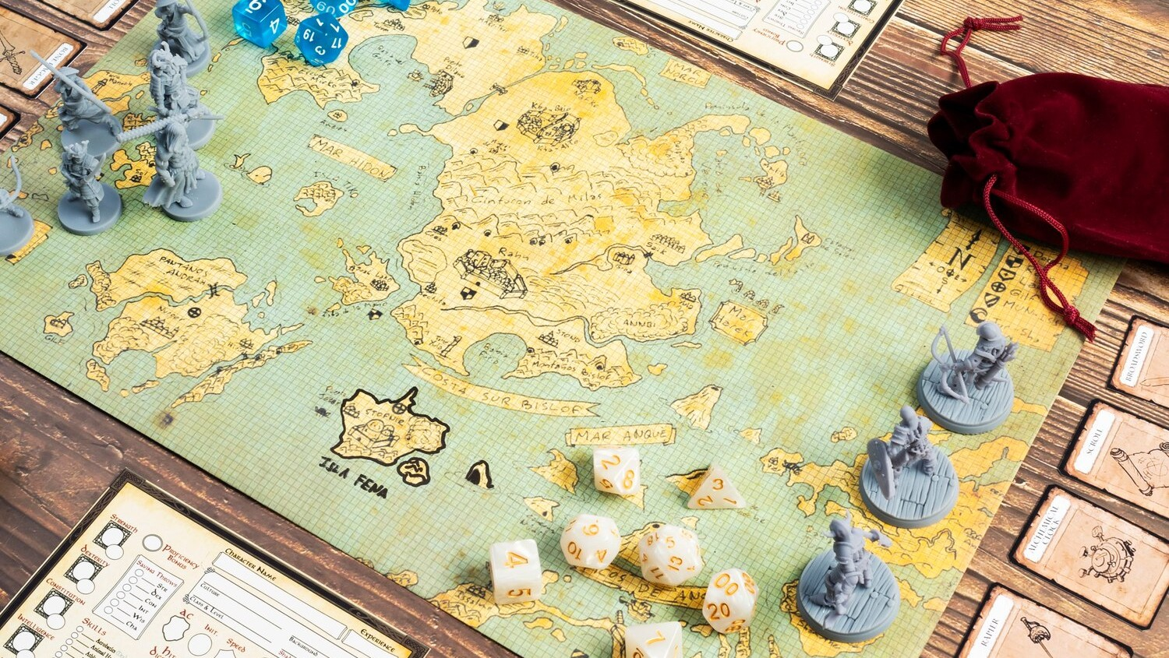
WELCOME TO QUIZZICAL QUEST!
Get ready to embark on a knowledge adventure like never before. Join us as we explore the fascinating world of online gaming and test your .

Slide 3

THE POWER OF ONLINE GAMING
Discover the immersive experience of online gaming, where learning meets fun. Engage with
and expand your knowledge in a dynamic and engaging environment.

Slide 4

Experience the thrill of learning through play as you tackle
and unlock a world of information. Engage in friendly
UNLEASHING KNOWLEDGE THROUGH PLAY
competition and expand your horizons.

Slide 5

THE ART OF STRATEGIC THINKING
Master the art of strategic thinking as you navigate through complex challenges and solve . Sharpen your problem-solving skills and unleash your creativity.

Slide 6

EXPLORING NEW FRONTIERS
Embark on a journey to explore new frontiers of knowledge and discovery. Engage with diverse topics and expand
your
in a dynamic and interactive setting.

Slide 7
EMBRACING THE FUTURE OF LEARNING
Join us in embracing the future of learning through the innovative world of online gaming. Unleash your potential, connect with a global community, and embark on a quizzical quest to expand your .

Slide 8
Thanks!

